Slide 1
Introduction to Git and Github

Slide 2
What is Git?
Git is a distributed version control system
Written by Linus Torvalds
Designed to handle both large and small projects
Allows tracking, branching, merging, and multiple workflows

Slide 3
Why Git?
Many features
Simple (for the basics)
Offline version control
Platform agnostic
Branching based workflow
…
Free and open source

Slide 4
What is Github?
Online host for Git repositories
Allows for ‘Social Coding’
Free for public projects
*private repositories possible too
Acts as server for collaborative projects

Slide 5
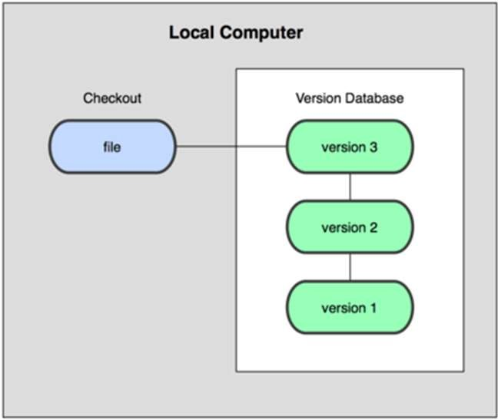
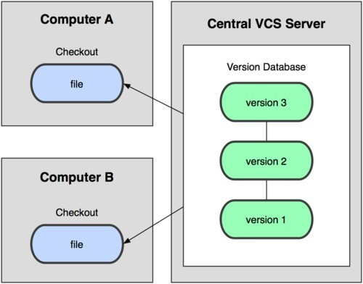
About version control
Version control records changes to a file or set of files over time
Local System
Centralized Version Control

Slide 6
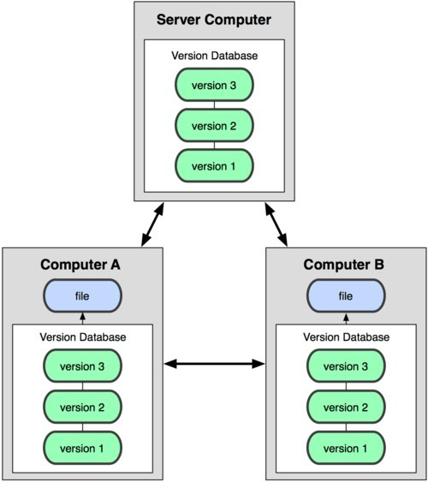
About version control
Distributed Version Control

Slide 7
Getting started
Git can be downloaded from:
https://git-scm.com/downloads
It’s easy to install, only binaries are required
Put Git on your PATH (or equivalent)
Run from Command, Shell, BASH, etc.

Slide 8
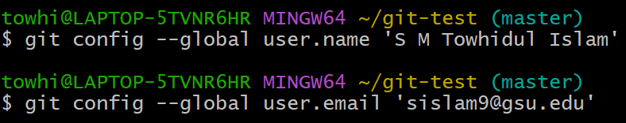
Setting up
Test current version of git [git --version]
Configure your Git [git config]
$ git config --global -l
Set your name, email address, and editor:
$ | git | config | --global | user.name ‘Your Name’
$ | git | config | --global | user.email ‘you@web.com’
$ | git | config | --global | core.editor ‘notepad’

Slide 9
The basics
Initialize a repository [git init]
Stage changes [git add]
View changes [git status] or [git diff]
Commit changes [git commit]
Add multiple files with wildcards
git add ‘*.txt’
Commit with an inline message
git commit –m ‘inline message here’
List the commits
git log

Slide 10



git init
Initializes a new git repository in a directory
This enables version control for the files within that directory
A hidden file ‘.git’ folder is created that contains the version history
git repository
script1.py
.git (hidden)
script2.py
script3.py
script4.py

Slide 11
git add
Changes to be added in next commit
E.g., stage the changes of ‘script1.py’:
git add script1.py
Stage all files (new/modified/deleted): git add --all
git repository
.git (hidden)

Slide 12
Git branching
file_a.txt
file_a.txt
file_a.txt
master
master
master
file_b.txt
master edits file_a
branch
merge
file_a.txt
file_a.txt
abranch
abranch
file_b.txt
branch edits file_a
branch adds file_b

Slide 13
Branching, merging, tracking
View the change log [git log]
* each commit has a unique number (sha)
Branch a repo [git branch]
Checkout the branch [git checkout]
Make changes, then add and commit
Merge the changes [git merge]

Slide 14
Exercise: Add, Commit, Branch, Merge
Try this typical workflow example:
Initialize a git repository
Make an initial commit
Create a new file in the repository
add changes
commit changes
branch repository
checkout new branch
make changes to new branch files
view the changes to your files: diff
merge branch to master

Slide 15
Github - Getting started
Create a Github account at https://github.com
Create a new repository (leave it blank)
It’s a good idea to give your repository and project the same name
Add a remote [git remote]
$ git remote add origin https://github.com/name/project.git
name = github account name
Push a repository [git push]
$ git push –u origin master
project = name of your project and/or repository

Slide 16
Collaborating via Github
Clone a repository [git clone]
Having made local changes, you can push (with permission), or make a pull request to the repository owner

Slide 17
Exercise: Add, Commit, Pull Request
Try this typical collaborative
workflow example:
clone to local machine
make changes
add changes
commit changes
push to repository
submit pull request

Slide 18

More information
h ttp://git-scm.com/about for introduction to Git
h ttp://git-scm.com/book for the nitty gritty
h ttp://gitref.org for a basic how-to guide
h ttps://github.com/ for overview of Github
h ttps://try.github.io for an interactive trial

